Slide 1

Auth in Web Apps

Slide 2
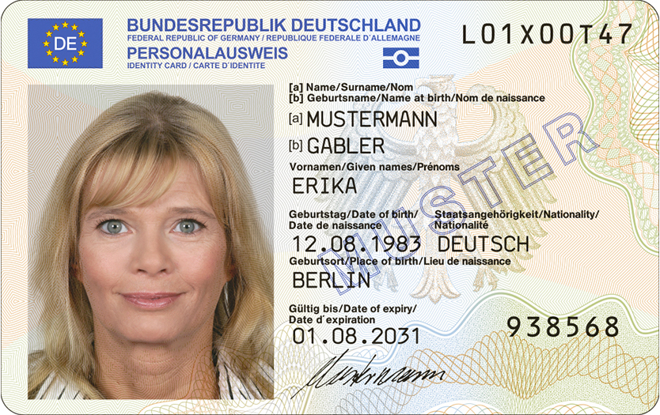
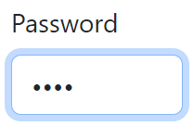

Identification vs. Authentication vs. Authorization: Know the difference.
Identification
Authentication
Authorization
Legitimacy checks KYC procedures
Confidence, fight against fraud and money laundering
Privacy and data breach concerns
Knowledge-, Possession-, Biometrics-based 1FA, MFA, SSO
Quicker process, less intrusive, less costly
Risk of impersonation, limited fraud detection
RBAC, ABAC, ReBAC, PBAC, Multi-party Authorization
Works in conjunction with authentication.
(Ex.) The customer provides legally secure proof of their identity to the bank.
(Ex.) The bank verifies that an individual accessing its services is still the same legitimate account holder.
(Ex.) The bank determines what services and resources a verified customer is permitted to access.
https://commons.wikimedia.org/wiki/File:Deutscher_Personalausweis_(2021_Version).jpg
https://oauth.net/images/oauth-logo-square.png
Notes:
Begrifflichkeiten klären
Auth, Authentication, Authorization wird oft vermischt
Identification != Authentication, aber sie ist enthalten
Authorization ist mit Authentication verknüpft

Slide 3

Part 1: Authentication
Verifying user identity claims.

Slide 4
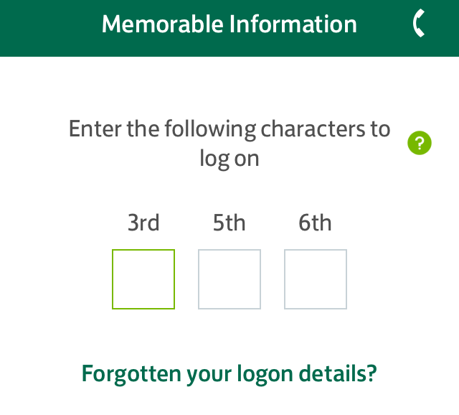
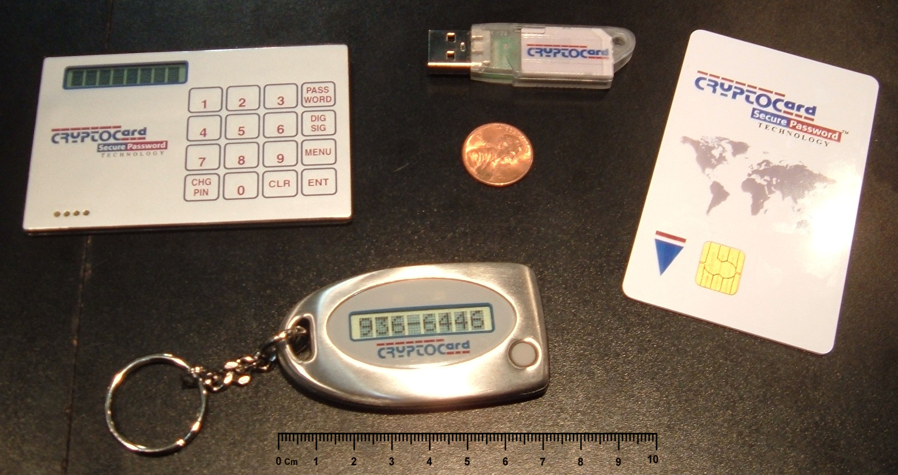

A practical overview of authentication methods.
Knowledge Secrets
Possession Ownership
Biometrics Inherence
Challenge Response (CRAM)
OTP
Partial Password
Passphrase
Password
Pattern
Personally Identifiable Information (PII)
PIN
Security Question
ID card
Implant
Smartcard
Smartphone
App
Phone Call
SMS
Smartwatch
Security Token
NFC
Software
USB
Wrist band
Brain waves
Breath
DNA sequence
Face
Fingerprint / Handprint
Gait (movement)
Iris / Retina
Keystroke dynamics
Signature
Voice
https://en.wikipedia.org/wiki/File:Partial_password_entry_form.png
https://commons.wikimedia.org/wiki/File:SecurityTokens.CryptoCard.agr.jpg
https://commons.wikimedia.org/wiki/File:Teerahertz_near-field_array_for_%CE%BCm-scale_surface_imaging_(cropped).png

Slide 5
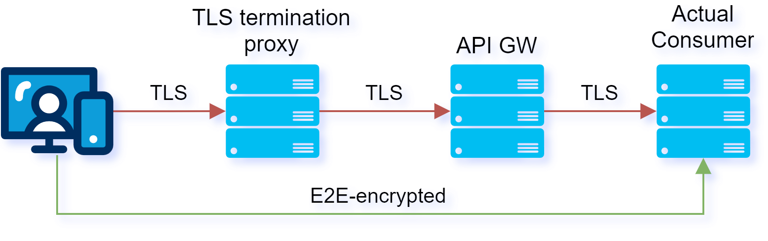
Keep your secrets: Transport-layer encryption leaks to TLS termination proxies.
Encrypt payloads containing secrets with public-key cryptography in client before transfer.
Include a variable part in the payload, ex. nonce or timestamp, to prevent dictionary attacks on the private key.
Only consumers knowing the private key can read the payload containing the secret.
Or if applicable, use a Zero-Knowledge Password Protocol.

Slide 6
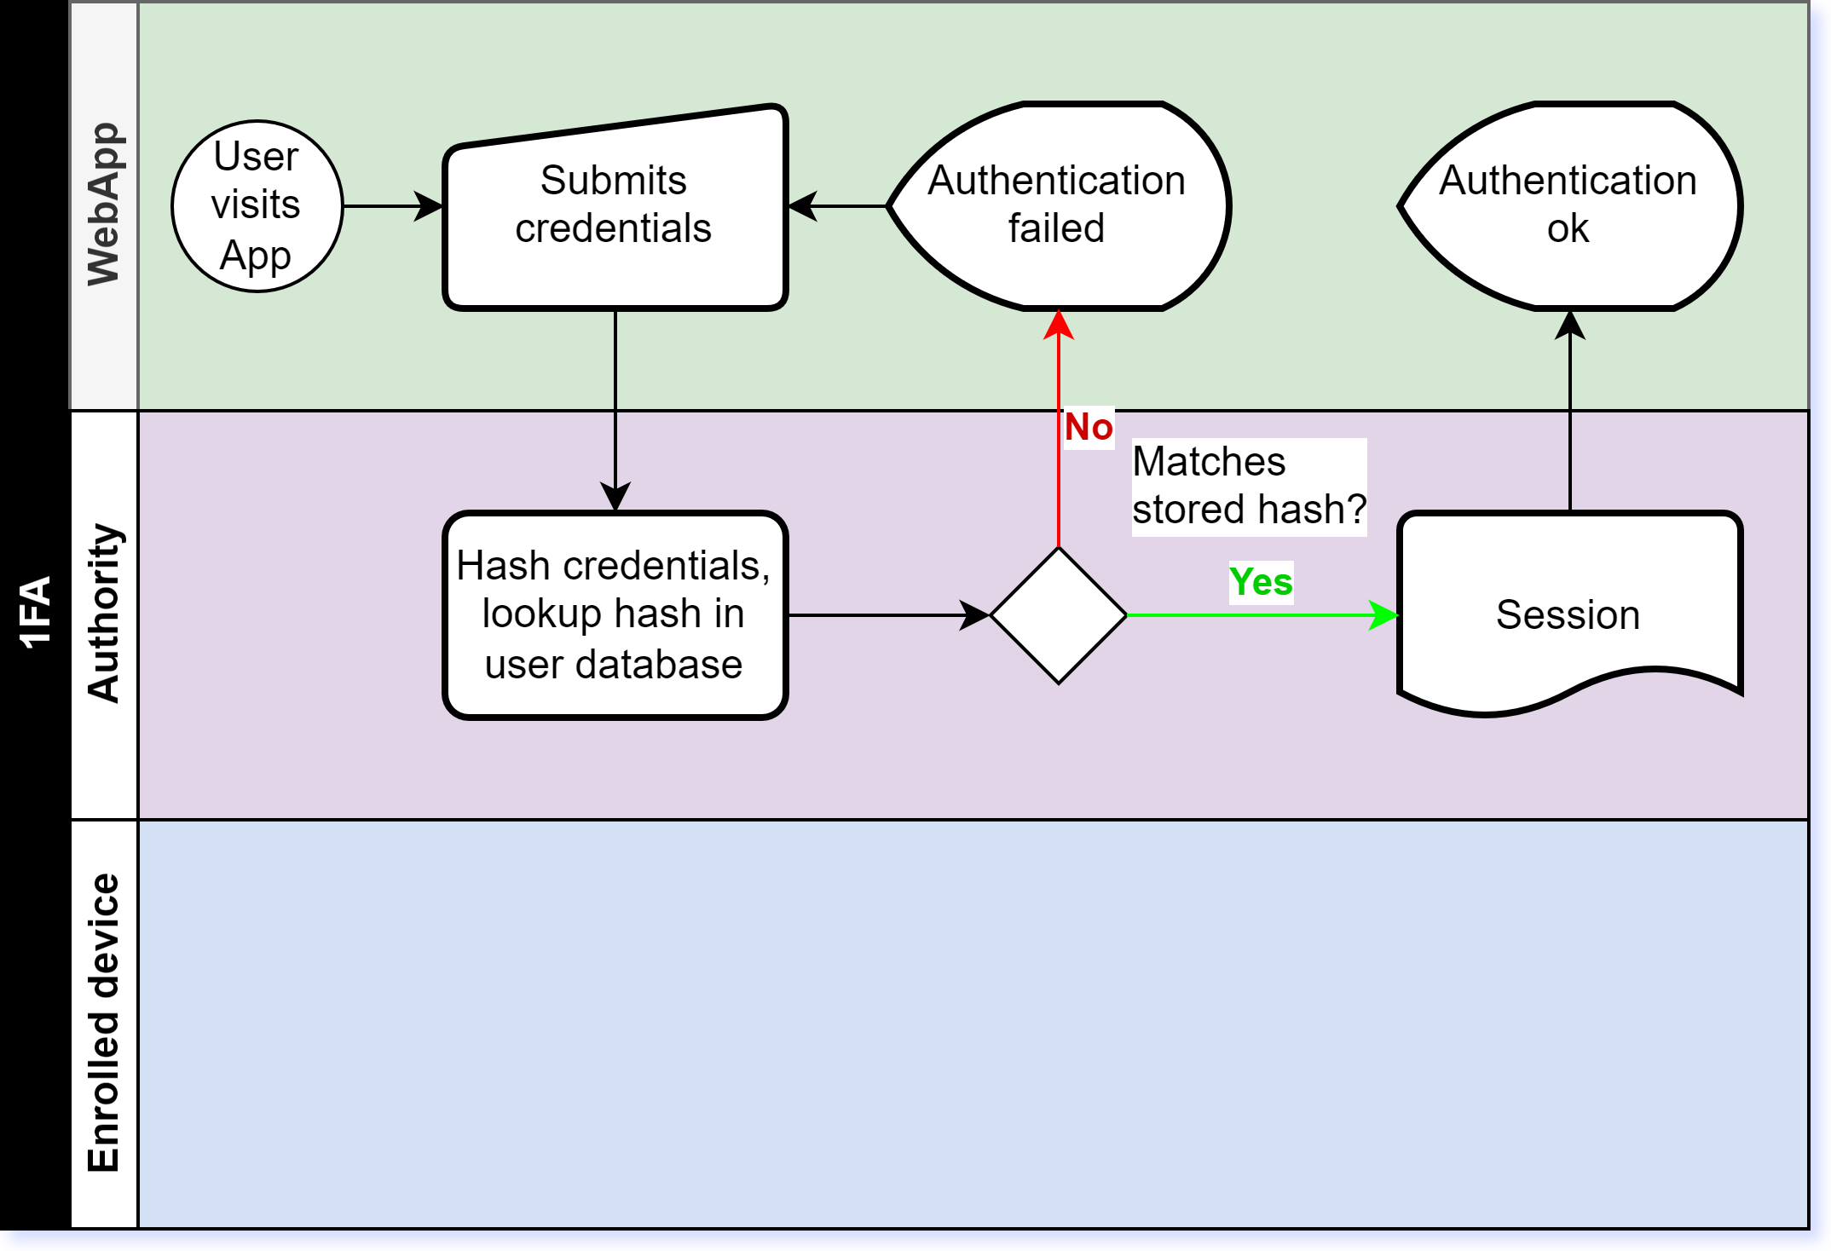
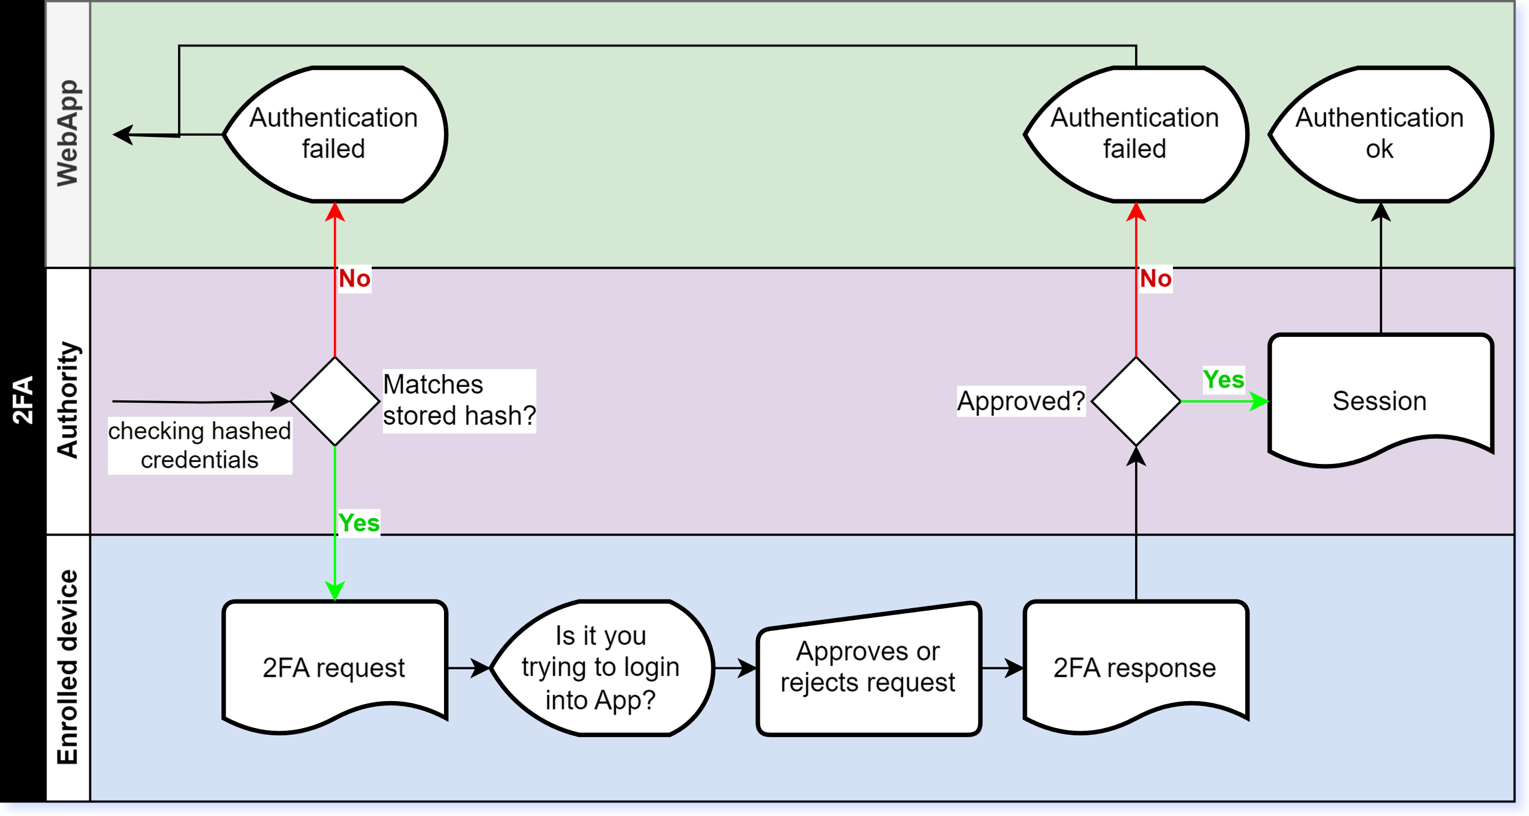
1FA vs MFA: Mitigating credential theft.
1FA Asks for only one factor to verify identity claim.
MFA Requires additional factors to verify identity claim.

Slide 7
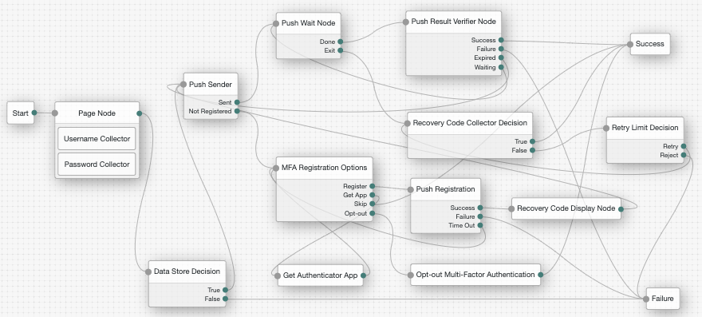
Modern approach to modelling authentication.
Authentication is complex
Collecting credentials
Retry limits
User locked status
MFA and passwordless authentication
Enrolled device recovery
Related use cases
Onboarding new users
Mandatory user profile migrations
https://backstage.forgerock.com/docs/am/7.5/authentication-guide/authn-mfa-trees-push.html

Slide 8
Rise of Identity and Access Management platforms.
 | Keycloak | ForgeRock (PingIdentity) | Auth0 (Okta)
Solution type | Open Source | Proprietary | Proprietary
Deployment model | Self hosted | Self hosted or Managed | Managed
Login and self services | Integrated app Customizable | Integrated app Customizable Configuration “Custom login” as redirect to custom app. | Integrated app Supports HTML templates, which enables loading custom app resources.
Authentication model | Linear Configurable flows and steps | Directed trees Configurable nodes Custom node implementations | Pipeline for modifying behavior Configurable actions Actions as custom functions

Slide 9
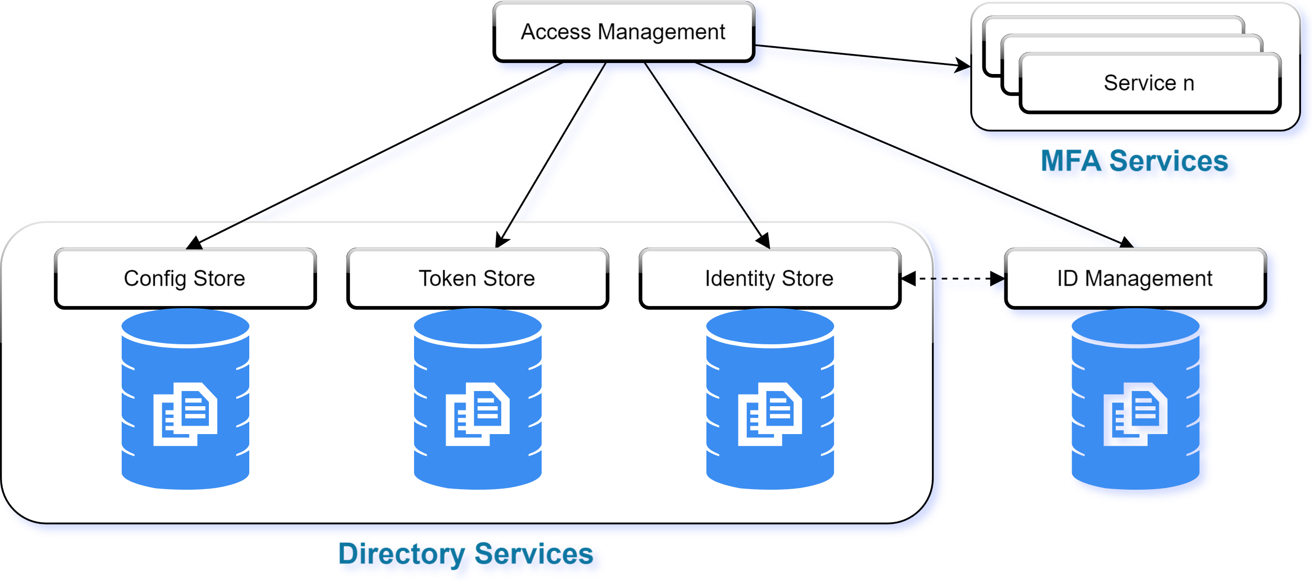
A simplified view of an IAM architecture.

Slide 10

Part 2: Authorization
Permitting access to resources.

Slide 11
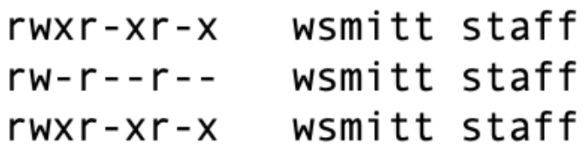
Controlling access to resources is a security concern.
Principle of {least privilege, minimal privilege, least authority}
Popular example: File permissions in POSIX.1-2017
Roles: User, Group, Other
Access: Read, Write, eXecute
General models: Roles, Attributes, Relationships, Policies
Context or time based
Multi-party authorization

Slide 12
Modelling access with Roles, Attributes and Relationships.
RBAC Roles
ABAC Attributes
ReBAC Relationships
(Ex.) Bank customers can read and update their account information. (Ex.) Bank employees can verify customer identities.
(Ex.) Bank customers of legal age can trade securities.
(Ex.) Bank customers cannot transfer from bank accounts under liquidation.
(Ex.) A bank customer can transfer from joined accounts shared with their life partner.
(Ex.) A bank customer can monitor the balances and transactions of a savings account owned by their child.

Slide 13
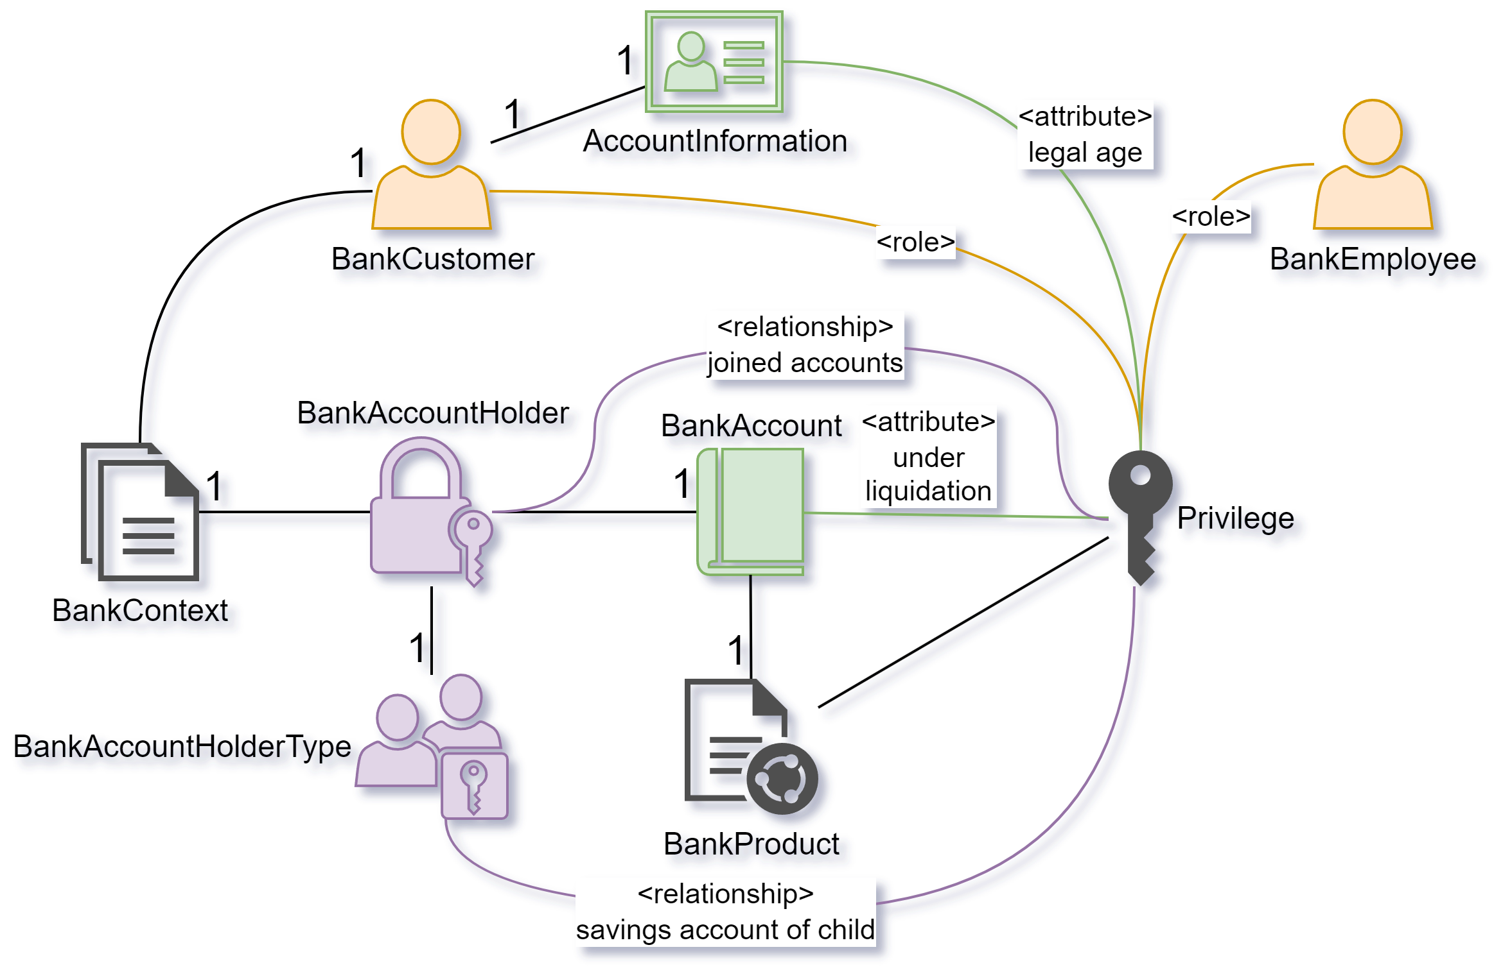
Let’s define an access control model intended for use within a bank.
Notes:
Informelles Model
als Hybrid aus den drei allgemeinen Modellen
zu den Beispielen

Slide 14

Part 3: Delegated authorization
Excursion into OAuth.

Slide 15
A service provider aggregates financial data from multiple sources in a central app.
Copy and paste financial data into the financial app manually.
Entrust your credentials to the service provider so that they can read financial data in your online banking.
Trust the service provider not to do more than they are supposed to do.
You let the online banking know that a specific service provider has access to your financial data.
Service providers can only access financial data that you approved.

Slide 16
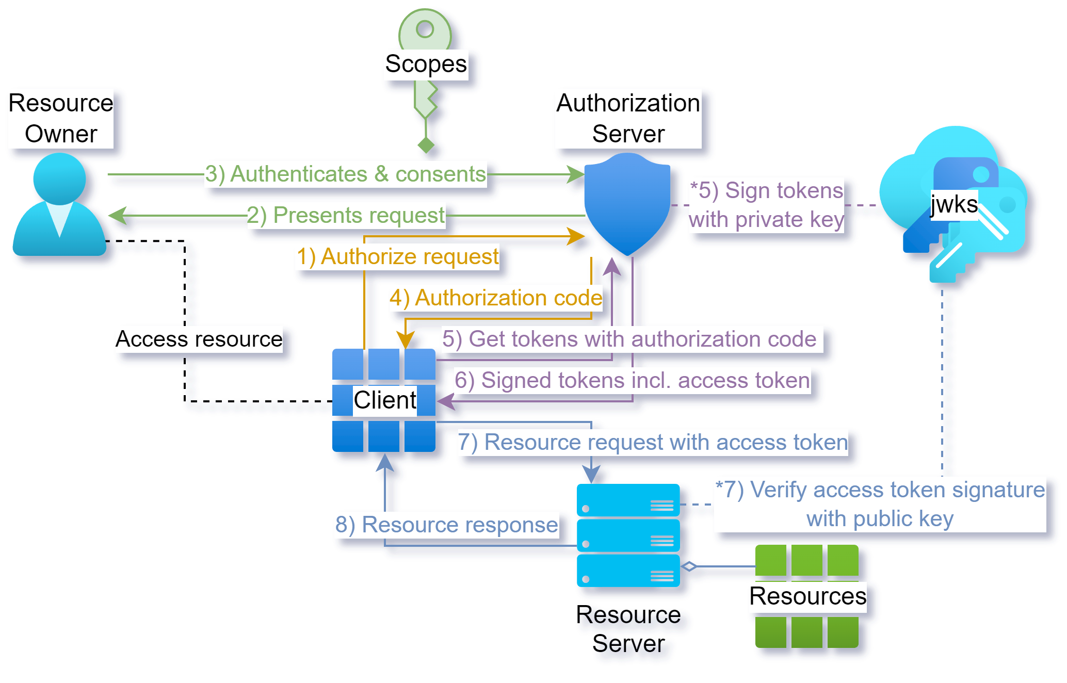
OAuth 2 as a standard protocol for delegated authorization.
*OAuth authorization code grant flow from steps 1) to 6)

Slide 17
Quick facts about OAuth.
Scopes in authorization requests are a mechanism to limit access to resources.
Tokens are signed JWTs to protect against tampering and forgery.
Tokens expire after a predefined lifetime.
The resource server validates access tokens without a request to the authorization server, which is often referred to as Stateless Authentication.
Different grant types for different use:
Authorization code → frontends, public clients
Client credentials → backends
Clients must not necessarily be third-party.

